Slide 1
Chapter 12
How Does the Internet Work?

Slide 2
ARPA
1969, DoD Advanced Research Projects Agency
Interested in the creation of reliable network

Slide 3
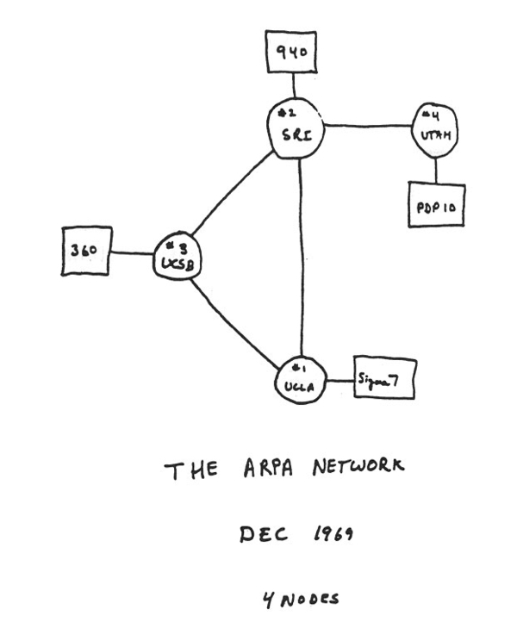
Initial Four, 1969

Slide 4
Timeline
http://www.cs.kent.edu/~javed/internetbook/hobbestimeline/HIT.html

Slide 5
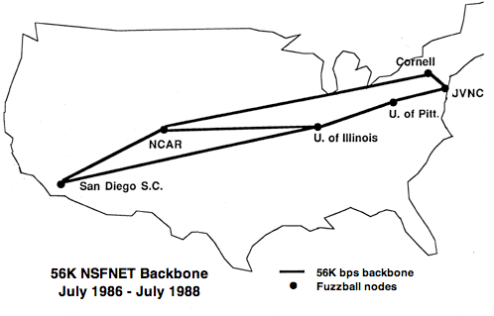
NSFnet 1986

Slide 6
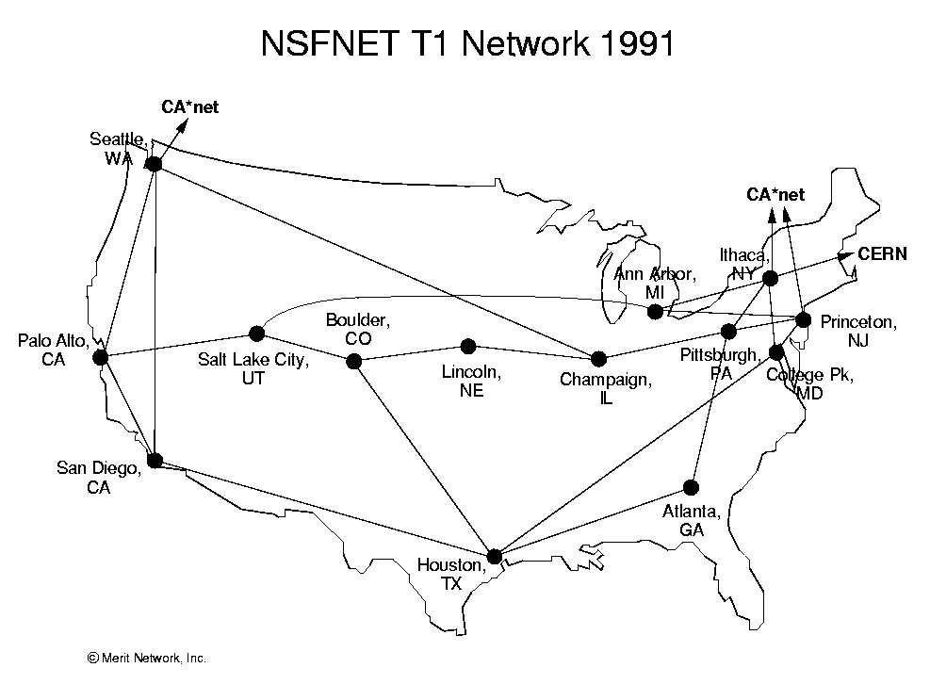
NSFnet 1991

Slide 7
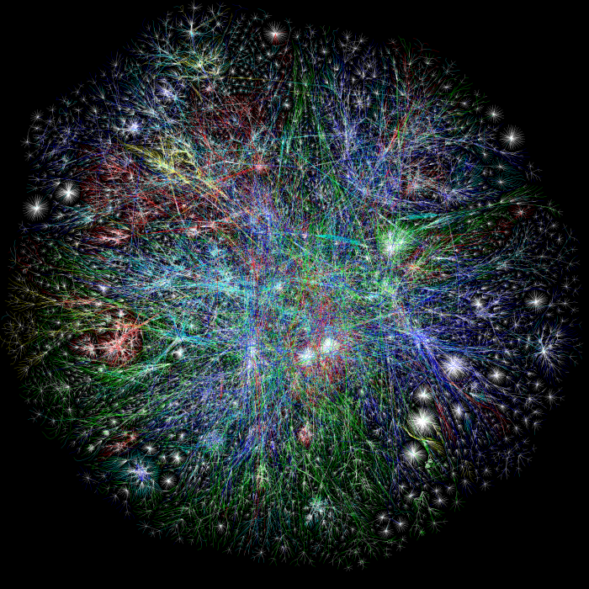
Now

Slide 8
Architecture
Multiple tiers
Backbone
Long-haul providers

Slide 9
Tier One Providers
AT&T -- United States
Cogent (formerly PSINet) -- United States
Deutsche Telekom -- Germany
GTT (formerly Tinet) -- United States & Italy
Level 3 Communications (formerly Level 3 and Global Crossing) -- United States
NTT Communications (formerly Verio) -- Japan
OpenTransit (Orange) – France
Sprint -- United States

Slide 10
Tier One Providers
Tata Communications (Acquired Teleglobe) -- India
Seabone (Telecom Italia Sparkle) -- Italy
TeliaSonera International Carrier -- Sweden & Finland
Verizon Enterprise Solutions (formerly UUNET) -- United States
XO Communications -- United States
Zayo Group (formerly AboveNet) -- United States
Hurricane Electric IPv6 Network -- United States

Slide 11
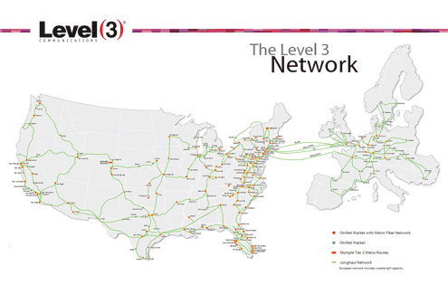

Slide 12
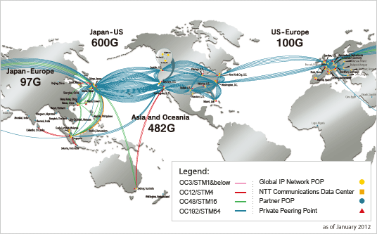
NTT

Slide 13
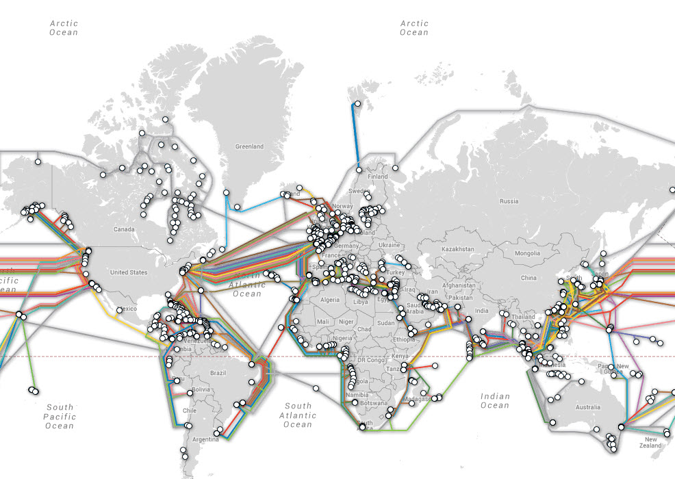
Underwater Cables

Slide 14
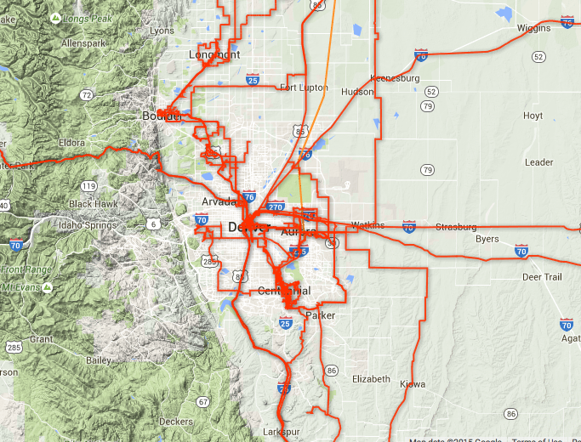
Level 3 Colorado
Notes:
http://maps.level3.com/default/

Slide 15
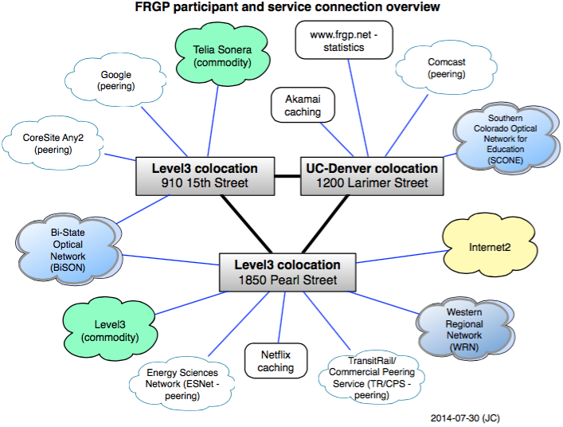
You Are Here

Slide 16
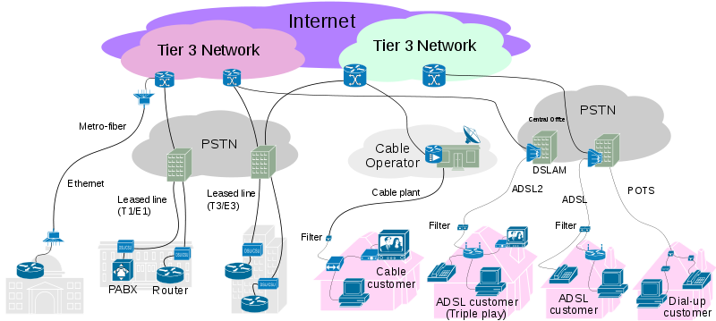
Hierarchy
Notes:
https://en.wikipedia.org/wiki/Internet_service_provider
Public switched telephone network

Slide 17
Coordination
Internet Society (ISOC)
Internet Architecture Board (IAB)
Internet Engineering Task Force (IETF)
Request For Comments (RFCs)
Standards (STDs)
Internet Research Task Force (IRTF)

Slide 18
Coordination
Internet Corporation for Assigned Names and Numbers (ICANN)
Top-Level Domains (TLDs)
Independent version of Internet Assigned Numbers Authority (IANA)
Not associated with US government
Each country controls within their borders

Slide 19
Addresses
Domain
Maps via DNS to
IP
Maps via ARP to
Ethernet

Slide 20
Domains
Original
.com, .org, .net, .edu, .gov, .mil
Two-letter countries: 280
Now
More specific
Total of 1082

Slide 21
Who Are You?
$ whois msudenver.edu
[…]
The EDUCAUSE Whois database is authoritative for the
.EDU domain. Domain Name: MSUDENVER.EDU
[…]
Registrant:
Metropolitan State University of Denver
PO Box 173362
Campus Box 96
Denver, CO 80217
UNITED STATES

Slide 22
Who Are You?
Administrative Contact:
Mike Hart
Director, Security, Networking, Asset Management, Procurement
Metropolitan State University of Denver
PO Box 173362
Campus Box 96
Denver, CO 80217
UNITED STATES
(303) 556-5074
mhart20@msudenver.edu

Slide 23
Who Are You?
Technical Contact:
Jesse Nguyen
Manager, Windows Server Administration
Metropolitan State University of Denver
PO Box 173362
Campus Box 96
Denver, CO 80217
UNITED STATES
(303) 556-4683
dnsadmin@msudenver.edu
Name Servers:
NS4.MSUDENVER.EDU 147.153.45.75
NS5.MSUDENVER.EDU 147.153.45.76

Slide 24
Look It Up
$ nslookup www.msudenver.edu
Server: 8.8.8.8
Address: 8.8.8.8#53
Non-authoritative answer:
Name: www.msudenver.edu
Address: 147.153.45.41

Slide 25
DNS Root Servers
a.root-servers.net 198.41.0.4, 2001:503:ba3e::2:30 VeriSign, Inc.
b.root-servers.net 192.228.79.201, 2001:500:84::b USC/ISI
c.root-servers.net 192.33.4.12, 2001:500:2::c Cogent Communications
d.root-servers.net 199.7.91.13, 2001:500:2d::d University of Maryland
e.root-servers.net 192.203.230.10 NASA (Ames Research Ctr)
f.root-servers.net 192.5.5.241, 2001:500:2f::f ISC
g.root-servers.net 192.112.36.4 US Department of Defense
h.root-servers.net 128.63.2.53, 2001:500:1::803f:235 US Army
i.root-servers.net 192.36.148.17, 2001:7fe::53 Netnod
j.root-servers.net 192.58.128.30, 2001:503:c27::2:30 VeriSign, Inc.
k.root-servers.net 193.0.14.129, 2001:7fd::1 RIPE NCC
l.root-servers.net 199.7.83.42, 2001:500:3::42 ICANN
m.root-servers.net 202.12.27.33, 2001:dc3::35 WIDE Project

Slide 26
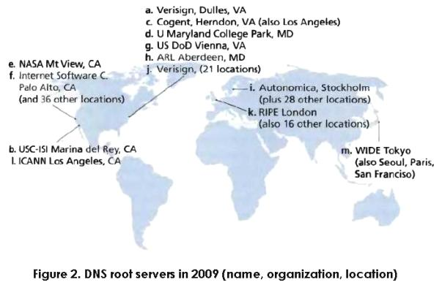
Root Servers

Slide 27
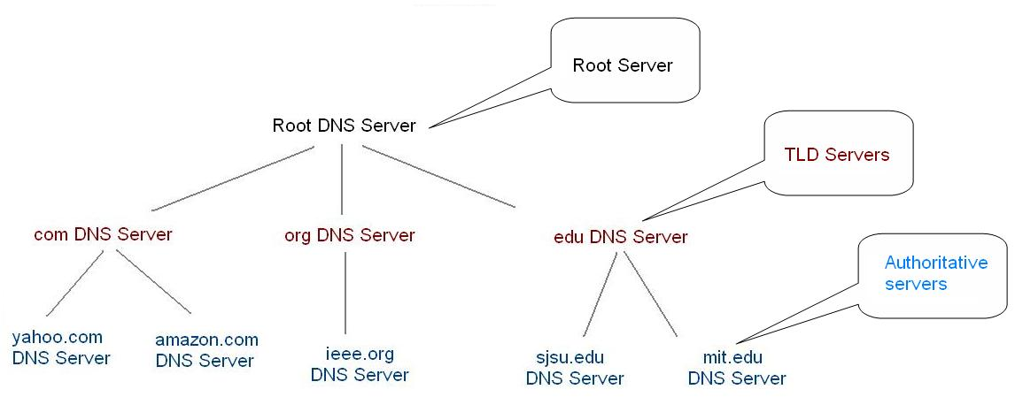
DNS Hierarchical
Notes:
https://upload.wikimedia.org/wikibooks/en/7/72/Strucutre-of-dns.jpg

Slide 28
IPv4
32 bits of address
Typically written in dotted octet form
Broken into five classes

Slide 29
Classes
 | Prefix | NW | Rest | Count | Addresses | Start | End
A | 0 | 8 | 24 | 128 | 16,777,216 | 0.0.0.0 | 127.255.255.255
B | 10 | 16 | 16 | 16,384 | 65,536 | 128.0.0.0 | 191.255.255.255
C | 110 | 24 | 8 | 2,097,152 | 256 | 192.0.0.0 | 223.255.255.255
D | 1110 |  |  |  |  | 224.0.0.0 | 239.255.255.255
E | 1111 |  |  |  |  | 240.0.0.0 | 255.255.255.255

Slide 30
IPv4 Issues
Not enough addresses
We’re essentially out
Underutilized
Several things have helped
Network Address Translation
Classless Inter-Domain Routing
Not easily routable

Slide 31
NAT
Translate many internal addresses to one or a few external address(es)
Use private IP address ranges internally
A: 10.0.0.0 - 10.255.255.255
16,777,216
B: 172.16.0.0 - 172.31.255.255
1,048,576
C: 192.168.0.0 - 192.168.255.255
65,536

Slide 32
NAT
Have to map connections via address/port pair
All ISPs do this
The address your machine uses is not what the rest of the world sees

Slide 33
CIDR
Remove strict 8-bit boundaries to classes
Now can subnet to assign portions of each class
E.g.: 192.193.194.0/28
Four bits for rest
16 addresses
1 each for network (192.193.194.0) and broadcast (192.193.194.15) and gateway (192.193.194.1)

Slide 34
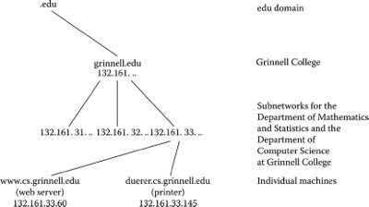
IP Address in Domain

Slide 35
ICANN Delegates
AfriNIC (African Network Information Center)
APNIC (Asia Pacific Network Information Center)
ARIN (American Registry for Internet Numbers)
LACNIC (Latin American and Caribbean Internet Addresses Registry)
RIPE NCC (Réseaux IP Européens Network Coordination Centre) assigns and manages IP addresses for Europe, the Middle East, and parts of Central Asia

Slide 36
IPv6
128 bits
Approximately 5×10²⁸ addresses for person
2⁵² addresses for every observable star in the known universe
Address every atom on the surface of the earth, and still have enough addresses left to do another 100+ earths
But not all released
Notes:
http://itknowledgeexchange.techtarget.com/whatis/ipv6-addresses-how-many-is-that-in-numbers/

Slide 37
Precisely
340,282,366,920,938,463,463,374,607,431,768,211,456
340- undecillion, 282- decillion, 366- nonillion
920- octillion, 938- septillion, 463- sextillion
463- quintillion, 374- quadrillion, 607- trillion
431- billion, 768- million, 211- thousand
456

Slide 38
IPv6
Geographic routing
Route aggregation
Fixed length headers
Jumbo grams/frames
Hexadecimal and colons

Slide 39
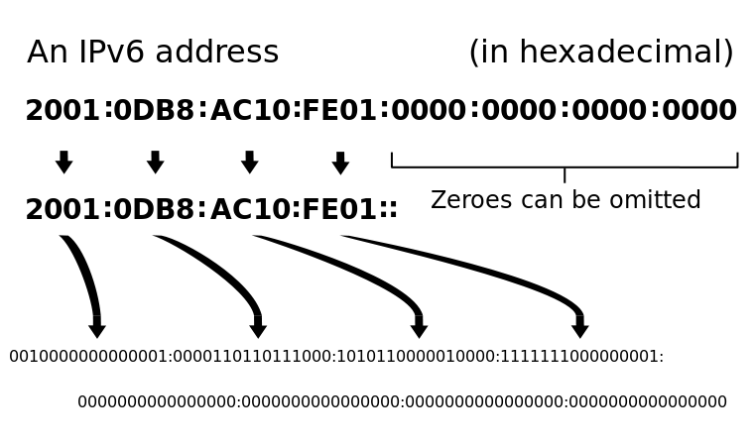
IPv6 Address

Slide 40
Special IPv6 Addresses
::1/128
Localhost
fe80::/64
Link local
ff00::/8
Multicast
2001::/16
Unicast assigned to ISPs

Slide 41
Example
en0: flags=8863<UP,BROADCAST,SMART,RUNNING,SIMPLEX,MULTICAST> mtu 1500
ether a4:5e:60:e8:b9:05
inet6 fe80::a65e:60ff:fee8:b905%en0 prefixlen 64 scopeid 0x4
inet 192.168.1.3 netmask 0xffffff00 broadcast 192.168.1.255
nd6 options=1<PERFORMNUD>
media: autoselect
status: active

Slide 42
Ethernet Addresses
48 bits
Manufacturers register with Institute of Electrical and Electronics Engineers (IEEE)

Slide 43
Who Is On This LAN?
$ ping 192.168.1.255
PING 192.168.1.255 (192.168.1.255): 56 data bytes
64 bytes from 192.168.1.11: icmp_seq=0 ttl=128 time=85.006 ms
64 bytes from 192.168.1.6: icmp_seq=0 ttl=80 time=85.151 ms
64 bytes from 192.168.1.4: icmp_seq=0 ttl=64 time=290.633 ms
64 bytes from 192.168.1.11: icmp_seq=1 ttl=128 time=4.172 ms
64 bytes from 192.168.1.6: icmp_seq=1 ttl=80 time=4.490 ms
64 bytes from 192.168.1.4: icmp_seq=1 ttl=64 time=115.507 ms
$ arp -a
? (192.168.1.1) at 74:44:1:45:f6:ab on en0 ifscope [ethernet]
? (192.168.1.4) at a0:99:9b:2:20:65 on en0 ifscope [ethernet]
? (192.168.1.6) at 9c:ad:ef:ff:6:2f on en0 ifscope [ethernet]
? (192.168.1.11) at 0:5:cd:35:aa:65 on en0 ifscope [ethernet]
? (192.168.1.255) at ff:ff:ff:ff:ff:ff on en0 ifscope [ethernet]

Slide 44
Connecting Laptops
Well, and most other machines too
Only servers typically don’t have dynamic addresses
Dynamic Host Configuration Protocol (DHCP)
IP address, gateway, netmask, DNS

Slide 45
Email
Originally only text
New Multipurpose Internet Mail Extensions (MIME)
Very flexible mechanism for attaching any kind of data
Also used in HTTP

Slide 46
Uses
Text in character sets other than ASCII
Non-text attachments: audio, video, images, application programs, etc.
Message bodies with multiple parts
Header information in non-ASCII character sets
Notes:
https://en.wikipedia.org/wiki/MIME

Slide 47
Type/Subtype
application/pdf pdf
audio/mpeg mpga mpega mp2 mp3 m4a
image/jpeg jpeg jpg jpe
text/html html htm shtml
video/mpeg mpeg mpg mpe

Slide 48
Headers
Content-Transfer-Encoding
Base 64
Content-Type
multipart/alternative
multipart/mixed

Slide 49
Trusting Email
Don’t
Pretty much everything can be faked
Exception: digital signatures
Pretty Good Privacy
Gnu Privacy Guard
https://gpgtools.org/
https://www.enigmail.net/home/index.php
http://gpg4win.org/

Slide 50
Email Delivery
Many viruses have been sent via email
Turn off all processing in your reader
Don’t automatically open apps
Maybe don’t show images

Slide 51
How They Get Our Address
Web page scraping
Google
Signing up
Selling of lists
Good guessing
admin@

Slide 52
Fighting SPAM
Alternate email addresses
For the various sites you sign up for
One you always ignore
Gmail: your.username+any.alias@gmail.com
White list those you know
Filter requiring interaction
Notes:
https://support.google.com/mail/answer/12096?hl=en

Slide 53
Fighting SPAM
Heuristics for recognition
More than N recipients
Click on “SPAM” button
Crowd sourcing
https://www.spamcop.net/
https://www.spamhaus.org/

Slide 54
Review
Questions: 3, 7, 10
Exercises: 2, 3, 6

